Slide 1

Working With Delta Tables

Slide 2
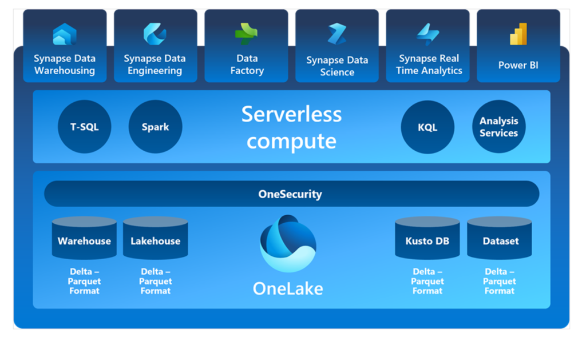
Delta Tables
Delta Lake is an open-source storage layer that adds relational database semantics to Spark-based data lake processing.
Delta tables are schema abstractions over data files that are stored in Delta format. For each table, the lakehouse stores a folder containing Parquet data files and a _delta_Log folder in which transaction details are logged in JSON format.

Slide 3
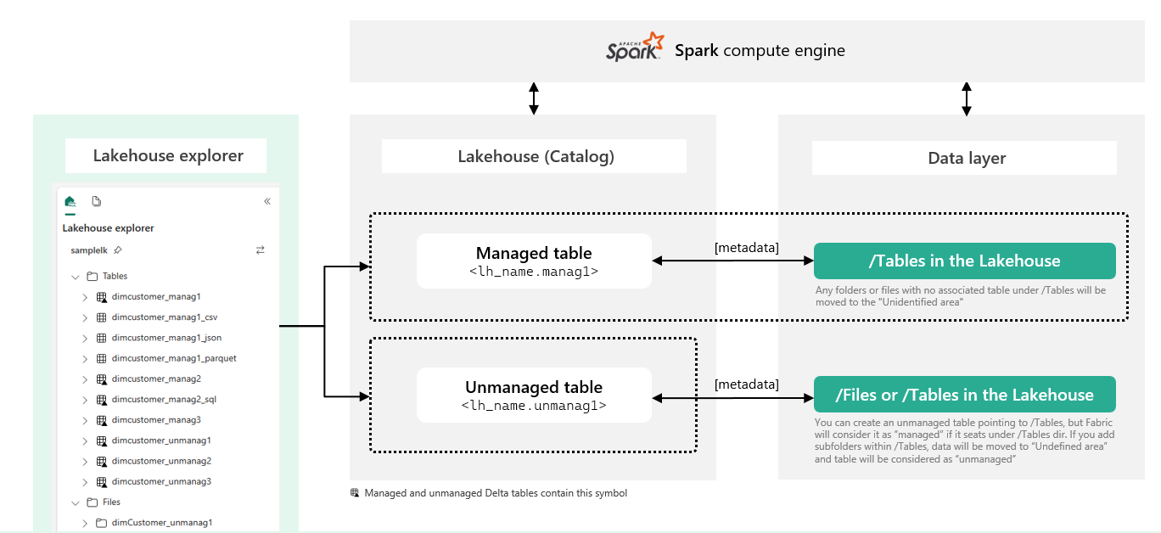
External and Managed Delta Tables
Managed Tables: In managed tables, the table definition in the metastore and the underlying data files are both managed by the Spark runtime for the Fabric lakehouse. Deleting the table will also delete the underlying files from the Tables storage location for the lakehouse.
External Tables: In external tables, the relational table definition in the metastore is mapped to an alternative file storage location. Deleting the external table will not delete the underlying files

Slide 4
Managed Delta Table
  # Load a file into a dataframe
  df = spark.read.load(‘Files/mydata.csv’, format=‘csv’, header=True)
  # Save the dataframe as a delta table
  df.write.format(“delta”).saveAsTable(“mytable”)
External Delta Table
  # Saving dataframe “df” as an external table
  df.write.format(“delta”).saveAsTable(“myexternaltable”, path=“Files/myexternaltable”)

Slide 5

Using Delta Tables for Streaming Data
Spark includes native support for streaming data through Spark Structured Streaming, an API that is based on a boundless dataframe in which streaming data is captured for processing. A Spark Structured Streaming dataframe can read data from many different kinds of streaming source, including:
Network ports
Real time message brokering services such as Azure Event Hubs or Kafka
File system locations.

Slide 6
Using Delta Table as a Streaming Source
  # Load a streaming DataFrame from the Delta table
  stream_df = spark.readStream.format("delta") \
  .option("ignoreChanges", "true") \
  .table("orders_in")
Using Delta Table as a Streaming Sink
  # Write the stream to a delta table
  output_table_path = 'Tables/orders_processed'
  checkpointpath = 'Files/delta/checkpoint'
  deltastream = transformed_df.writeStream.format("delta").option("checkpointLocation", checkpointpath).start(output_table_path)
  print("Streaming to orders_processed...")

Slide 7
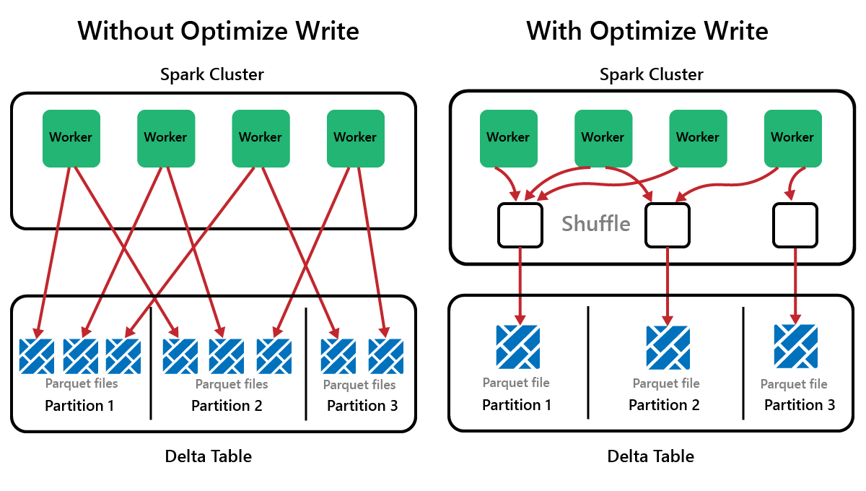
Optimize Delta Tables with OptimizeWrite Function
Parquet files are immutable, with new files written for every update or delete.
This process can result in Spark storing data in a large number of small files, known as the small file problem.

Slide 8
OptimizeWrite Function
  # Disable Optimize Write at the Spark session level
  spark.conf.set("spark.microsoft.delta.optimizeWrite.enabled", False)
  # Enable Optimize Write at the Spark session level
  spark.conf.set("spark.microsoft.delta.optimizeWrite.enabled", True)
  print(spark.conf.get("spark.microsoft.delta.optimizeWrite.enabled"))

Slide 9
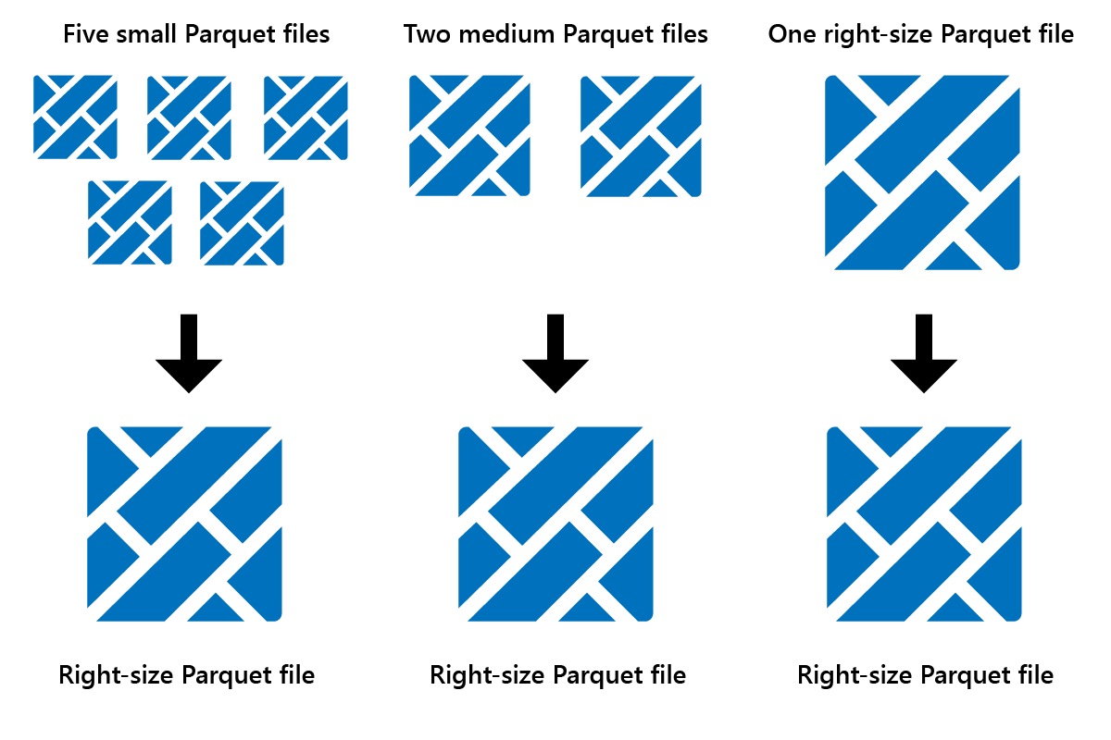
Optimize V-Order Function
Optimize is a table maintenance feature that consolidates small Parquet files into fewer large files.
V-Order Functionality: When you run Optimize, you can optionally run V-Order, which is designed for the Parquet file format in Fabric. V-Order enables lightning-fast reads, with in-memory-like data access times. It also improves cost efficiency as it reduces network, disk, and CPU resources during reads.
V-Order might not be beneficial for write-intensive scenarios such as staging data stores where data is only read once or twice. In these situations, disabling V-Order might reduce the overall processing time for data ingestion.

Slide 10
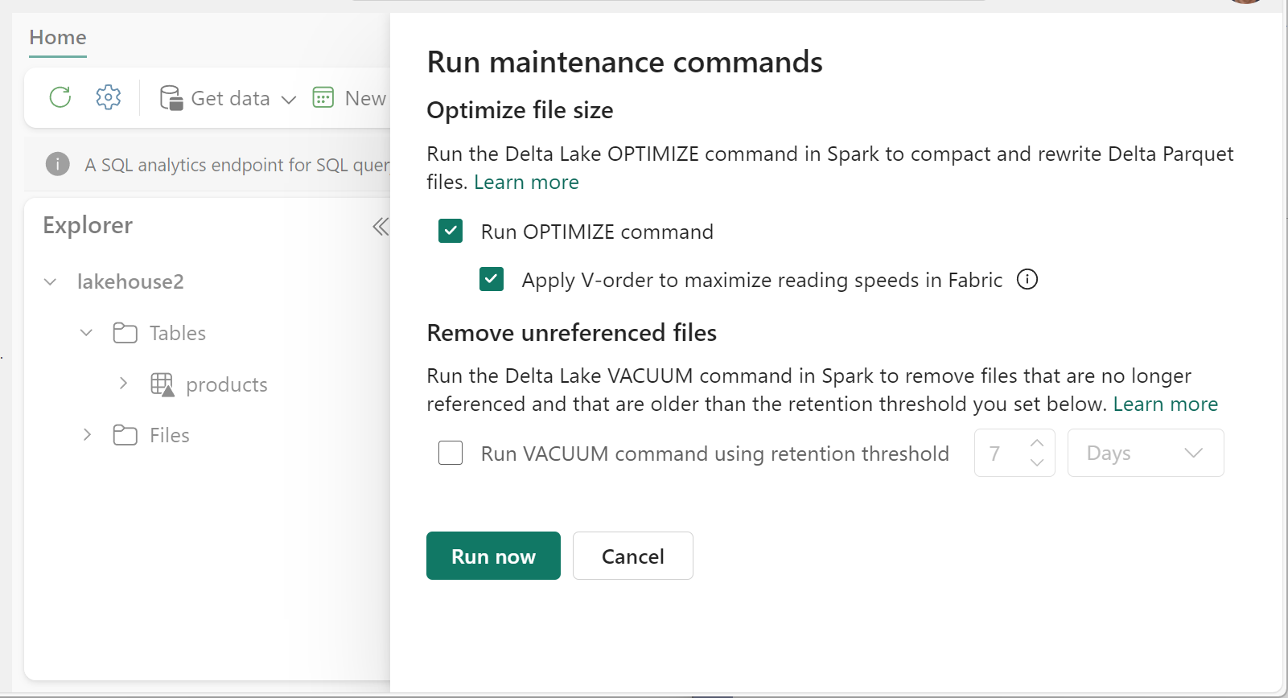
V-Order Function

Slide 11
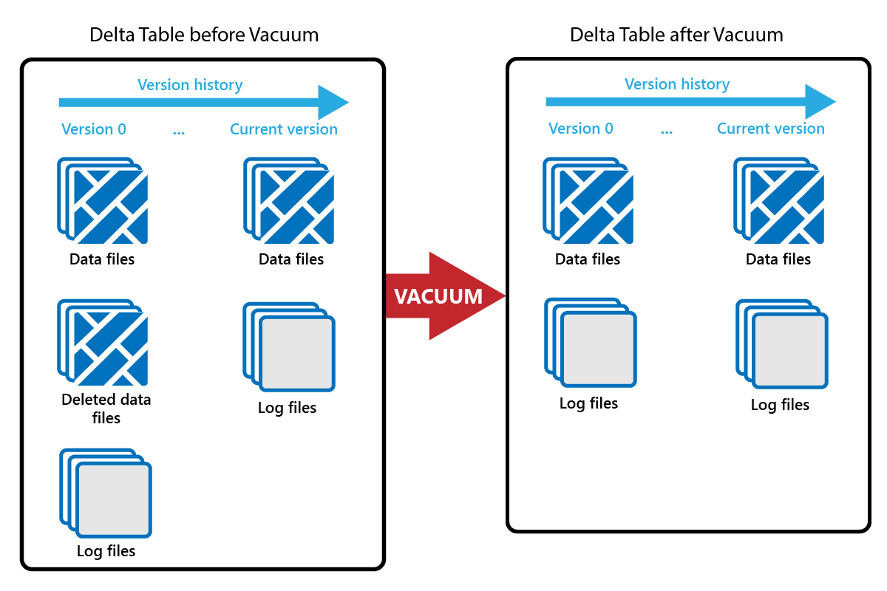
Vacuum Command
Every time an update or delete is done, a new Parquet file is created, and an entry is made in the transaction log. Old Parquet files are retained to enable time travel, which means that Parquet files accumulate over time.
The VACUUM command removes old Parquet data files, but not the transaction logs. When you run VACUUM, you can't time travel back earlier than the retention period.

Slide 12
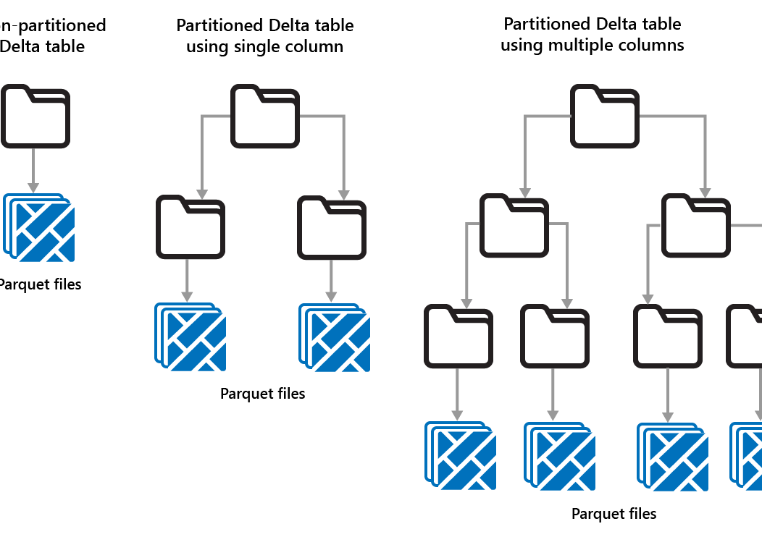
Partitioning Delta Tables
Use partitioning when:
You have very large amounts of data.
Tables can be split into a few large partitions.
Don't use partitioning when:
Data volumes are small.
A partitioning column has high cardinality, as this creates a large number of partitions.
A partitioning column would result in multiple levels.

Slide 13
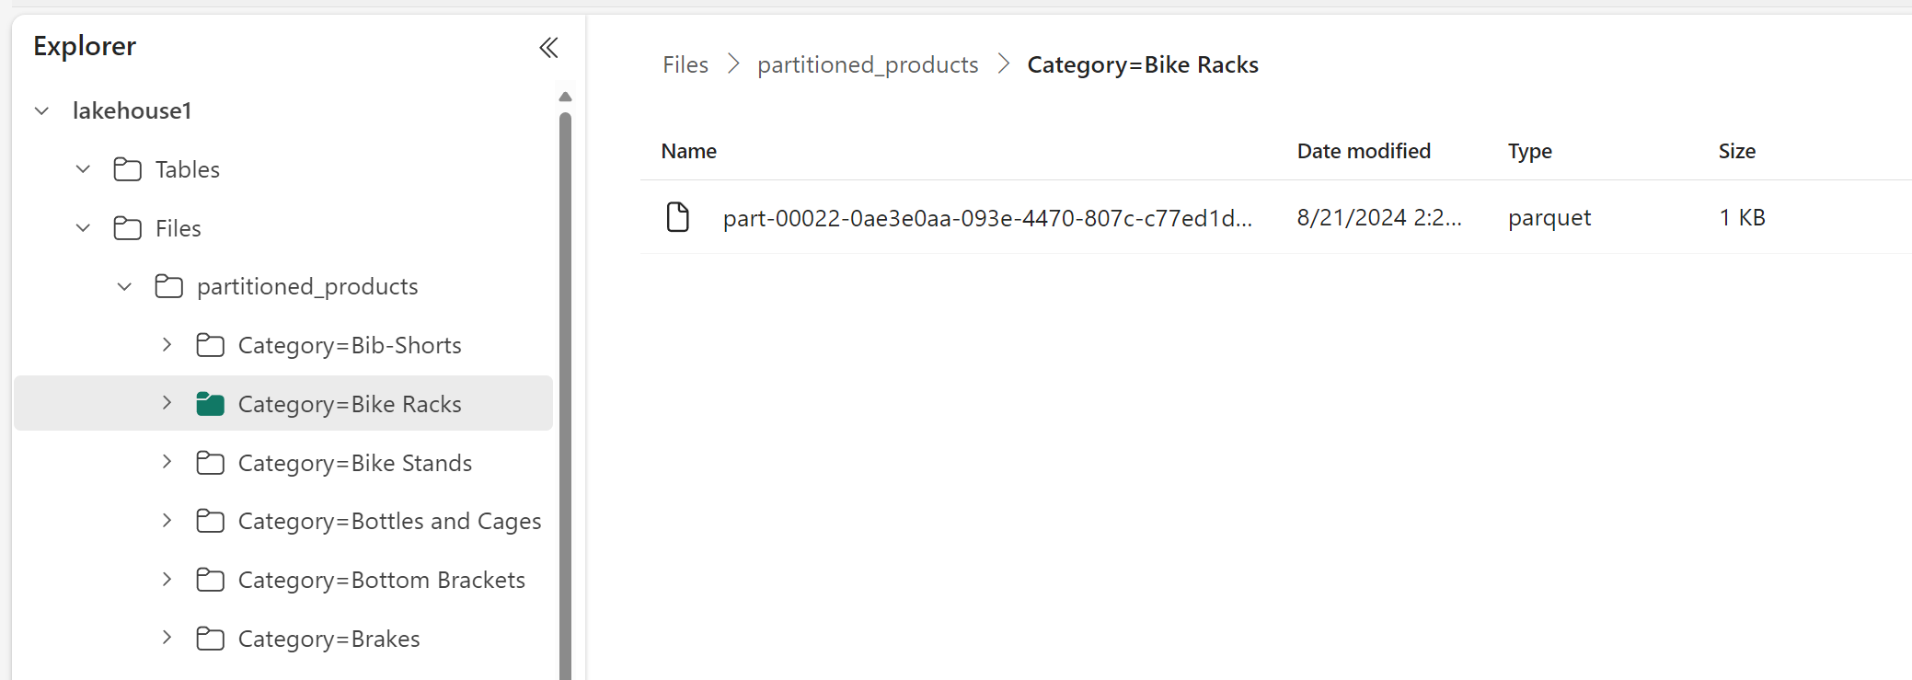
  # Partitioning Delta Table by “Category”
  df.write.format("delta").partitionBy("Category").saveAsTable("partitioned_products", path="abfs_path/partitioned_products")

